Slide 1
Biological Modeling of Neural Networks:
Week 15 – transients and rate models
15.1 Review Populations of Neurons
- Transients
15.2 Rate models
-
Week 15 – Fast Transients and
Rate models
Wulfram Gerstner
EPFL, Lausanne, Switzerland

Slide 2
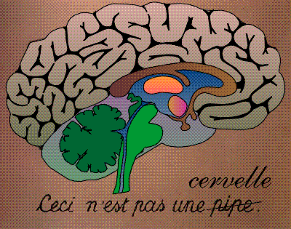
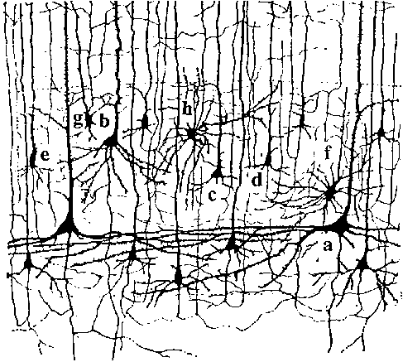
Neuronal Dynamics – Brain dynamics is complex
Week 15-part 1: Review: The brain is complex
10 000 neurons
3 km of wire
motor
cortex
1mm
frontal
cortex
to motor
output

Slide 3
Week 15-part 1: Review: Homogeneous Population
Example: 2 populations
excitation
Homogeneous population:
each neuron receives input
from k neurons in the population
-each neuron receives the same
(mean) external input (could come from
other populations)
each neuron in the population has roughly
the same parameters
inhibition

Slide 4
Week 15-part 1: Review: microscopic vs. macroscopic
I(t)
microscopic:
spikes are generated
by individual neurons
spikes are transmitted
from neuron to neuron
macroscopic:
Population activity An(t)
Populations interact via
An(t)

Slide 5
Week 15-part 1: Review: coupled populations
I(t)

Slide 6

Week 15-part 1: Example: coupled populations in barrel cortex
Neuronal Populations
= a homogeneous group of neurons
(more or less)
Populations:
- pyramidal neurons in layer 5 of barrel D1
- pyramidal neurons in layer 2/3 of barrel D1
- inhibitory neurons in layer 2/3 of barrel D1
100-2000 neurons
per group (Lefort et al., NEURON, 2009)
different barrels and layers, different neuron types → different populations

Slide 7
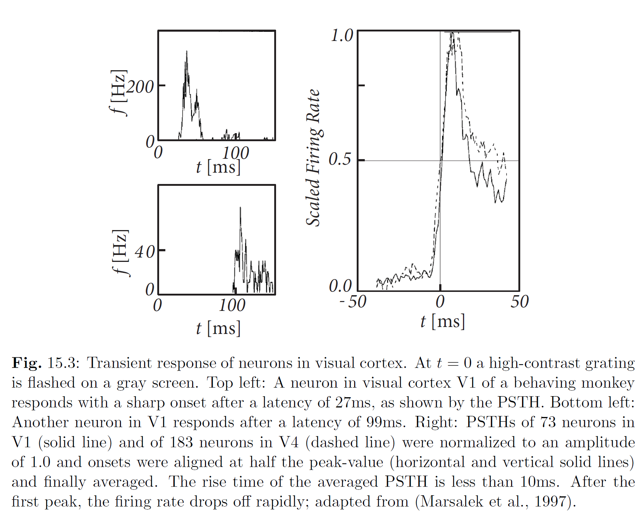
Week 15-part 1: A(t) in experiments:light flash, in vivo
Experimental data: Marsalek et al., 1997
aligned
PSTH, many neurons in
V1 (solid)
V4 (dashed)
PSTH, single neurons

Slide 8
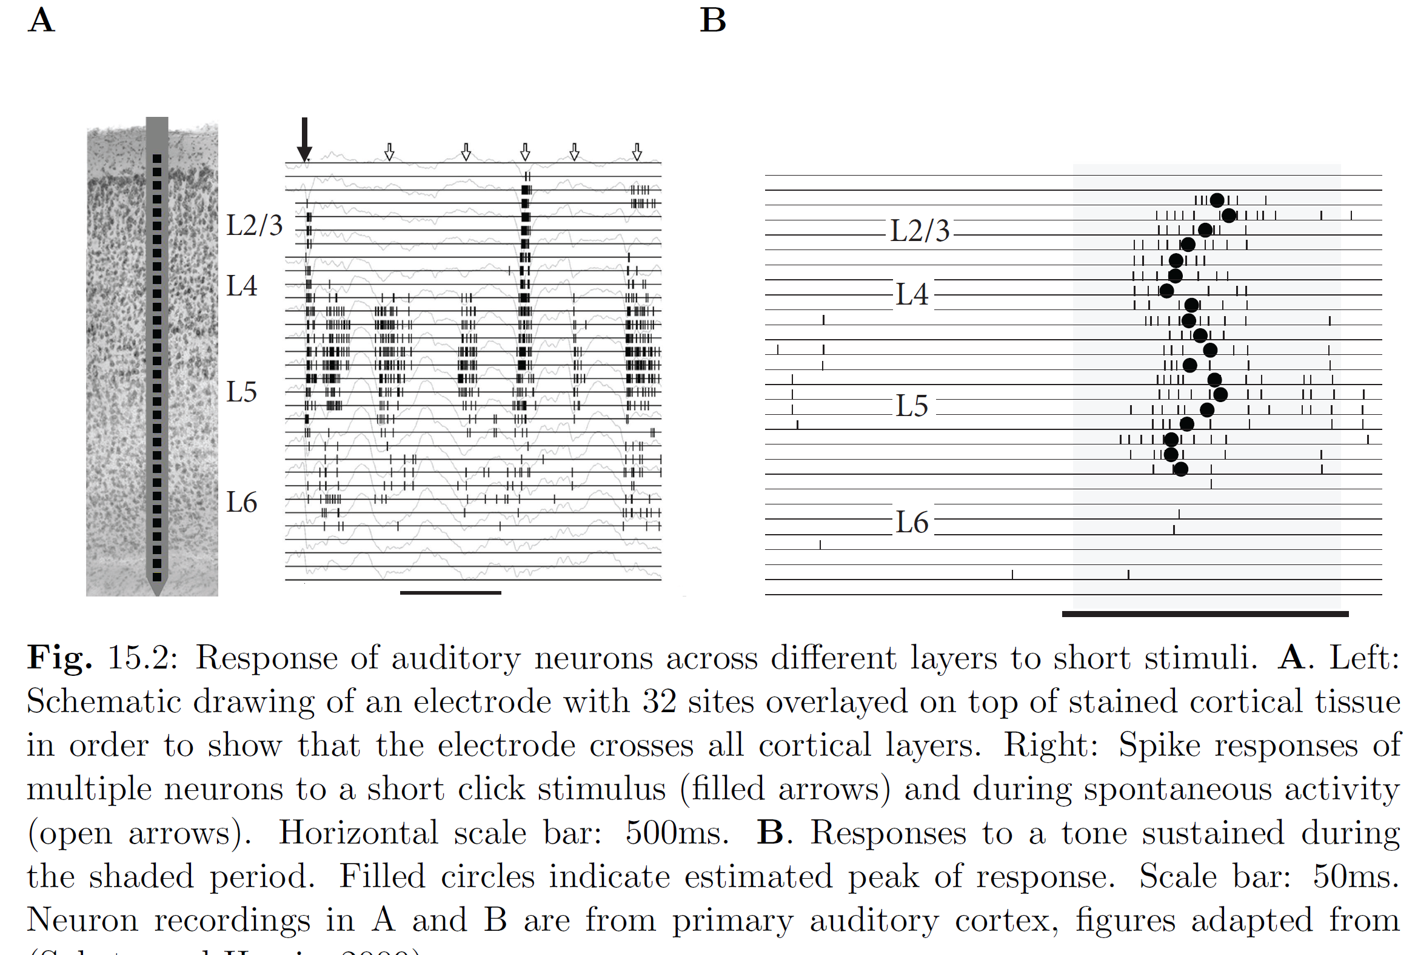
Week 15-part 2: A(t) in experiments: auditory click stimulus
Experimental data: Sakata and Harris, 2009

Slide 9
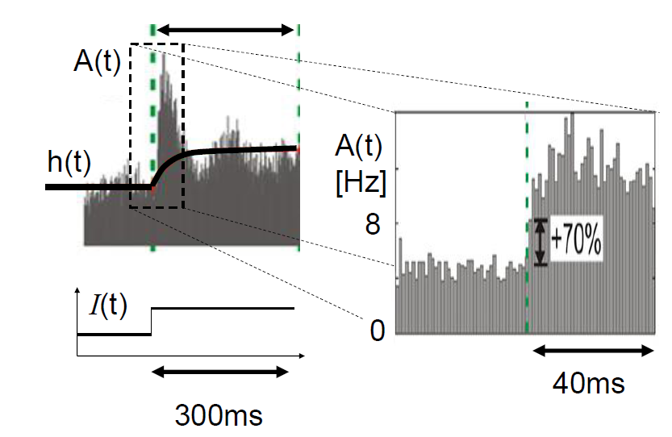
Week 15-part 1: A(t) in experiments: step current, (in vitro)
Experimental data: Tchumatchenko et al. 2011
See also: Poliakov et al. 1997

Slide 10
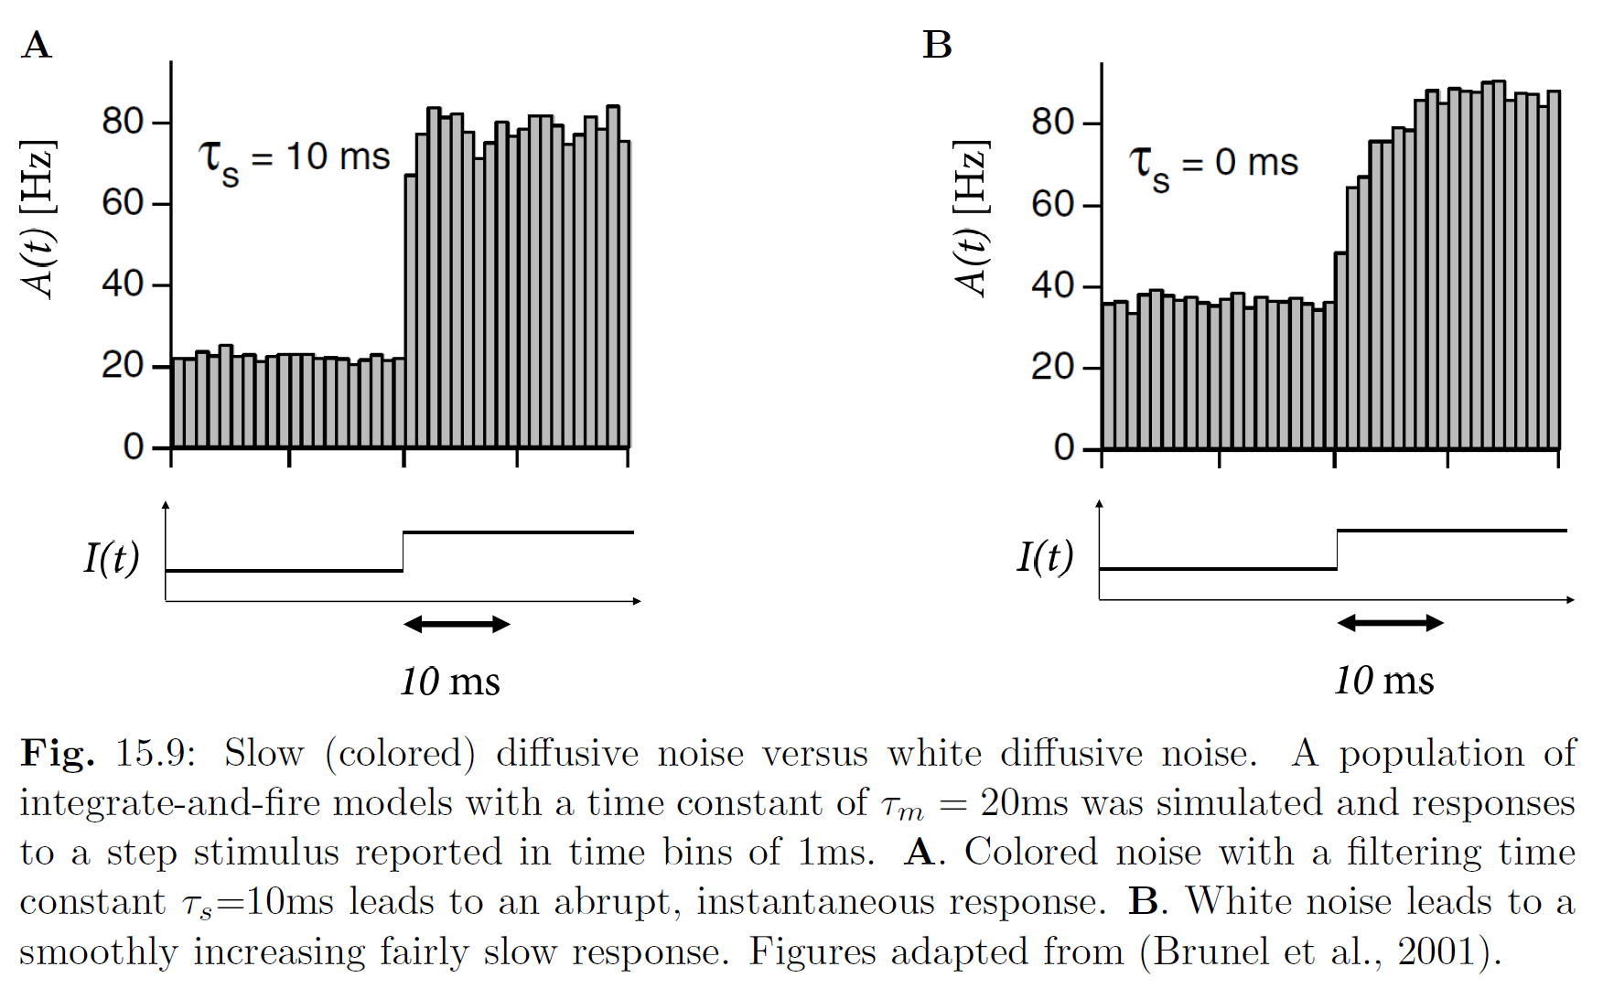
Week 15-part 1: A(t) in simulations of integrate-and-fire neurons
Simulation data: Brunel et al. 2011
Image:
Gerstner et al.,
Neuronal
Dynamics,
2014

Slide 11
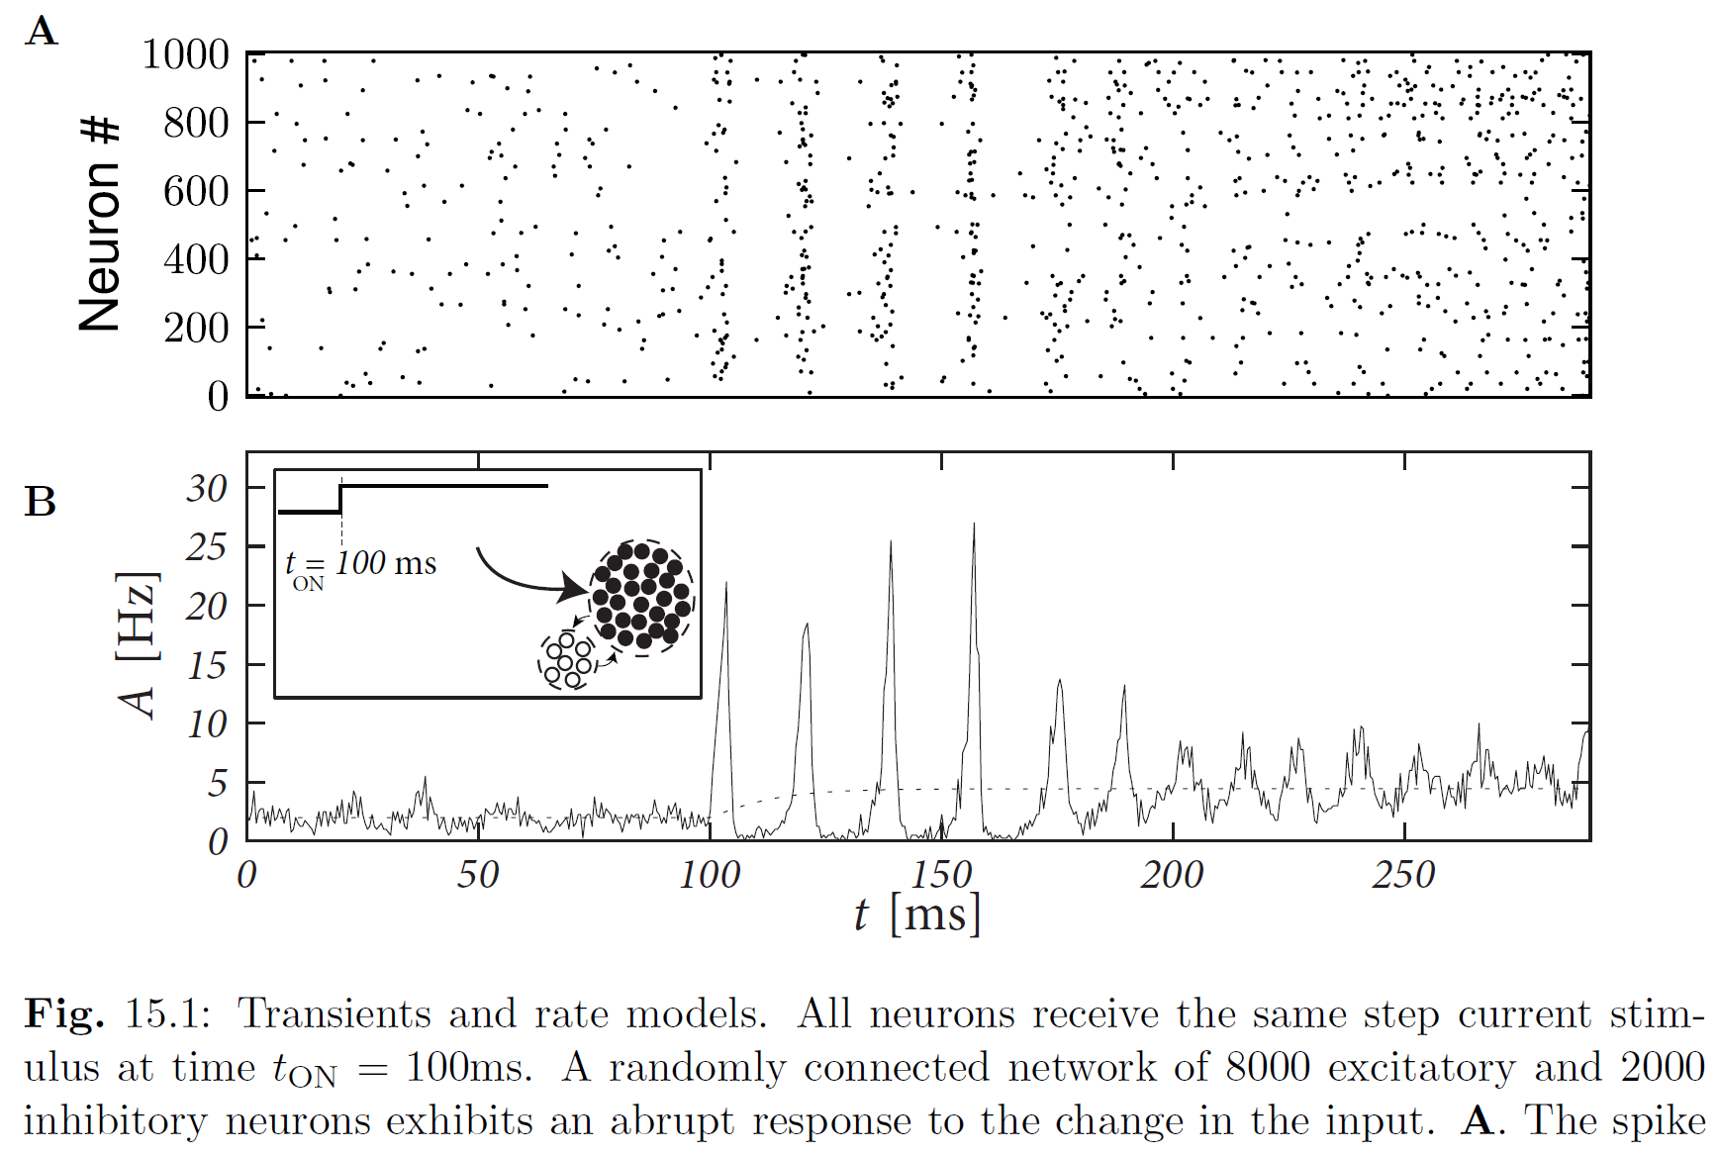
Week 15-part 1: A(t) in simulations of integrate-and-fire neurons
Simulation data:
Image:
Gerstner et al.,
Neuronal
Dynamics,
2014

Slide 12
Biological Modeling of Neural Networks:
Week 15 – transients and rate models
Conclusion of part 1
Week 15 – Fast Transients and
Rate models
Transients are very fast
In experiments
In simulations of spiking neurons
Wulfram Gerstner
EPFL, Lausanne, Switzerland

Slide 13
Week 15-part 2: Rate model with differential equation
Input potential
→
I(t)
h(t)
Differential equation can be integrated!, exponential kernel

Slide 14
Week 15-part 2: Rate model : step current
A(t)
I(t)
h(t)
Input potential
Example LNP rate model: Linear-Nonlinear-Poisson
Spikes are generated by a Poisson process, from rate model

Slide 15
Week 15-part 2: Wilson-Cowan model : step current
A(t)
I(t)
h(t)
Input potential

Slide 16

Week 15-part 2: Aim: from single neuron to population
Single neurons
- model exists
- parameters extracted from data
- works well for step current
- works well for time-dep. current
I(t)
Population of Neurons?
Population equation for A(t)
-existing models
- integral equation

Slide 17
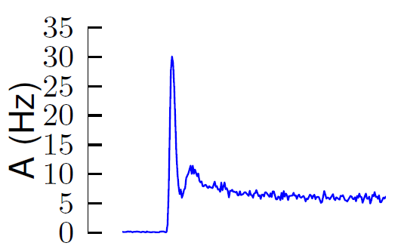
Week 15-part 2: A(t) in simulations : step current
25000 identical model neurons (GLM/SRM with escape noise)
parameters extracted from experimental data
response to step current
simulation data:
Naud and Gerstner, 2012
I(t)
h(t)
Input potential

Slide 18
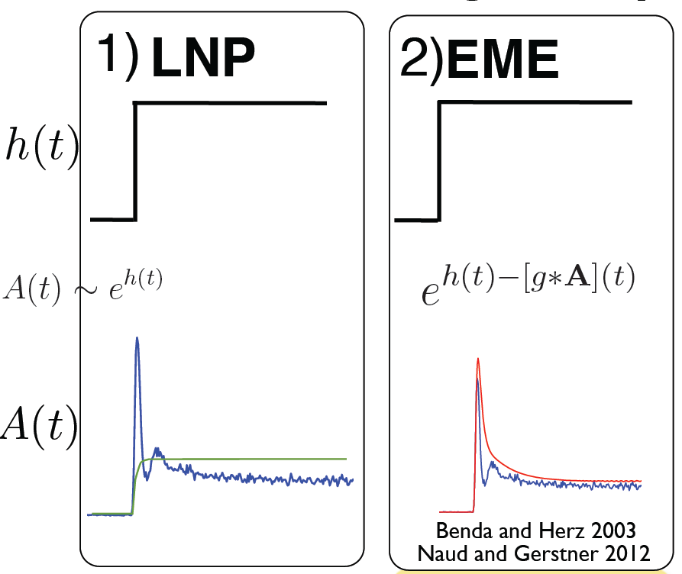
Week 15-part 2: rate model
Rate adapt.
I(t)
simulation
LNP theory
Simple rate model:
- too slow during the transient
- no adaptation
Benda-Herz
optimal filter
(rate adaptation)

Slide 19
Week 15-part : rate model with adaptation
Rate adapt.
I(t)
simulation
LNP theory
Benda-Herz
optimal filter
(rate adaptation)

Slide 20
Week 15-part 2: rate model
Simple rate model:
- too slow during the transient
- no adaptation
Rate adapt.
Adaptive rate model:
- too slow during the transient
- final adaptation phase correct
Benda-Herz
optimal filter
(rate adaptation)
Rate models can get the slow dynamics and stationary state correct, but are wrong during transient

Slide 21
Week 15-part 2: population equation for A(t) ?
t
I(t)
?
Question: – what is correct?
h(t)
potential
population
activity
Wilson-Cowan
A(t)
Ostojic-Brunel
Paninski, Pillow
A(t)
LNP
A(t)
current
Poll!!!
Benda-Herz
A(t)

Slide 22
Week 15-part 2: improved rate models/population models
Improved rate models
a) rate model with effective time constant
→ next slides
b) integral equation approach
→ chapter 14
optimal filter
(rate adaptation)

Slide 23
Week 15-part 2: Rate model with effective time constant
Ostojic-Brunel, 2011
Input potential
→
I(t)
h(t)
→ Shorter effective time constant during high activity

Slide 24
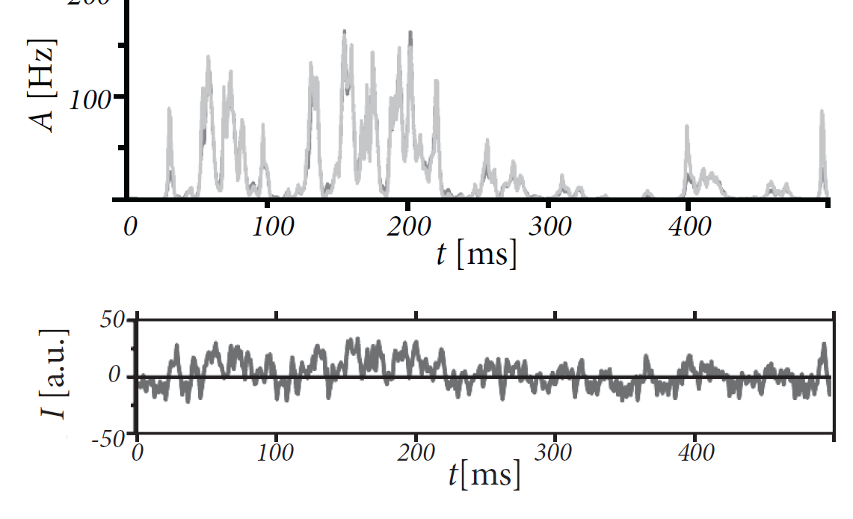
Week 15-part 2: Rate model with effective time constant
Image: Gerstner et al.,
Neuronal Dynamics, CUP 2014
Ostojic-Brunel, 2011
Shorter effective time constant during high activity
Theory fits simulation very well

Slide 25
Week 15-part 2; Conclusions
Rate models
- are useful, because they are simple
- slow dynamics and stationary state correct
- simple rate models have wrong transients
- improved rate models/population activity models exist
optimal filter
(rate adaptation)

Slide 26
The end
Reading: Chapter 15 of
NEURONAL DYNAMICS,
Gerstner et al., Cambridge Univ. Press (2014)

